Slide 1
Mental Disorders & Suicide

Slide 2
What words do you think of when you hear MENTAL HEALTH?

Slide 3
What is Mental Health
Is the way people think about and respond to events in their daily lives
Characterized by abnormal
Thoughts
Feelings
Moods
Ability to relate to others
Daily functioning

Slide 4
Emotions
A feeling produced into response to a life event
Emotional Health
The way a person experiences & deals with feelings

Slide 5
Teens & Emotions
Physical & Social Changes in teens
Freedoms, responsibilities, and new experiences
Hormones
Chemicals that help control how the body grows and functions
Released into blood by brain and other organs called GLANDS
Affects:
Emotions
Mood Changes
Energy Level

Slide 6
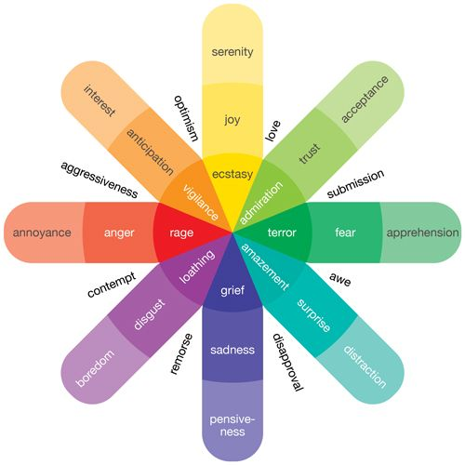
Emotional Spectrum
A set of emotions arranged by how pleasant they are
Emotions on spectrum are opposite:
Happiness & sadness
Love & hate

Slide 7
Triggers
Situations, people and events that cause a person to feel an emotion
Different emotional Triggers:
Affect people differently
Allows you to understand you emotions
Predict how a situation will affect you
Avoid situations that cause unpleasant emotions
Seek out situations that cause pleasant emotions
May not be able to avoid triggers

Slide 8
Communication Skills
Body Language
Expressing emotions with the face, hands, and posture
Active Listening
Showing that you understand what a person is saying

Slide 9
LIST YOUR WINS WORKSHEET

Slide 10
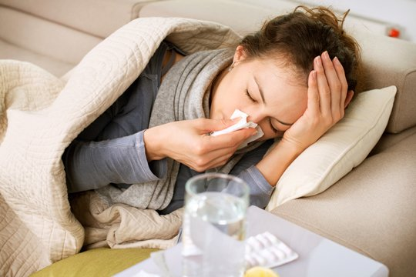
Bell Ringer
How do you think physical illnesses are different and similar to mental illnesses?

Slide 11
Mental Illness
Disorder that affects a person’s thoughts, emotions, and behaviors
1 out of 6 people have a mental illness
Causes :
Not completely understood
Inherited
Stressful Events
Environment

Slide 12
Anxiety Disorders
An illness that causes unusually strong nervousness, worry, or panic
Affect 40 million Americans over 18
Women are 60% more likely to develop the disorder than men
8 % of adolescents have the disorder
Types of disorders
Phobia Disorder
Panic Disorder
Obsessive-Compulsive Disorder

Slide 13
Specific Phobias
Phobia
– a group of symptoms brought on by certain objects or situations
How might fears affect normal living?
5-12% of Americans have phobias
Different types of phobias

Slide 14
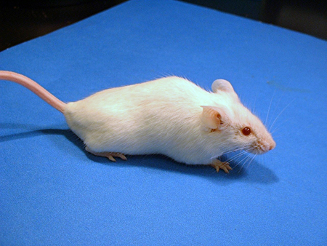
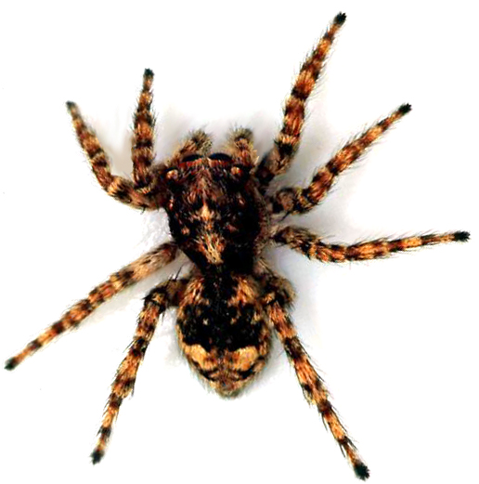
Animal Phobias
Most common specific phobias
Examples
Dogs
Snakes
Insects
Mice

Slide 15
Situational Phobias
Examples?
Flying
Riding in a car or bus
Driving
Going over bridges / through tunnels
Being in a closed place ( Elevator)

Slide 16
Natural Environment Phobias
Examples?
Storms
Heights
Water

Slide 17
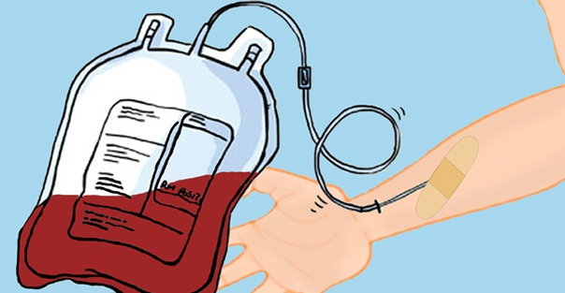
Blood-Injection-Injury Phobias
Examples?
Being injured
Seeing blood
Invasive medical procedures
Blood tests/injections

Slide 18
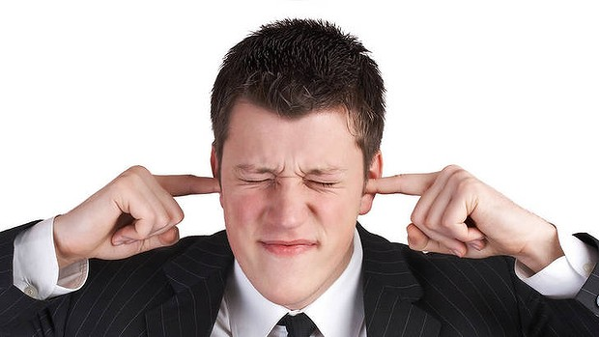
Other Phobias
Examples?
Falling down
Fear of loud sounds
Costumed characters
Clowns

Slide 19
Panic Disorder
Anxiety disorder that causes a person to have brief periods of extreme anxiety called Panic Attacks
Symptoms

Slide 20
Obsessive Compulsive Disorder ( OCD)
Obsessions
Anxiety that is triggered by repetitive thoughts
Compulsions
Develop Rituals
OCD
Combination of obsessions & compulsions
Treatment
Medicines
Counseling

Slide 21
Common Obsessions of OCD
Fear of dirt/ contamination by germs
Fear of causing harm to another
Fear of making a mistake
Fear of being embarrassed or behaving in a socially unacceptable manner
Fear of thinking evil or sinful thoughts
Need for order, symmetry, or exactness
Excessive doubt and need for constant reassurance

Slide 22
Common Compulsions
Repeatedly bathing
Refusing to shake hands or touch doorknobs
Repeatedly checking things
Constantly counting
Constantly arranging things in a certain way
Eating foods in specific order
Being stuck on words, images or thoughts that won’t go away
Repeating words
Needing to perform tasks a certain number of times
Collecting / hoarding items

Slide 23
OCD Video Clip
http://abcnews.go.com/WNT/video/extreme-affliction-ocd-16046438

Slide 24
Lifetime Prevalence of Selected Psychological Disorders Among Americans
Disorder | Men (%) | Women (%)
Anxiety Disorders Simple Phobia | 6.7 | 15.7
Social Phobia | 11.1 | 15.5
Panic Disorder | 2.0 | 5.0
OCD | 1.7 | 2.8
PTSD | 5.0 | 10.4

Slide 25
Bell Ringer
Predict the difference between anxiety and mood disorders.

Slide 26
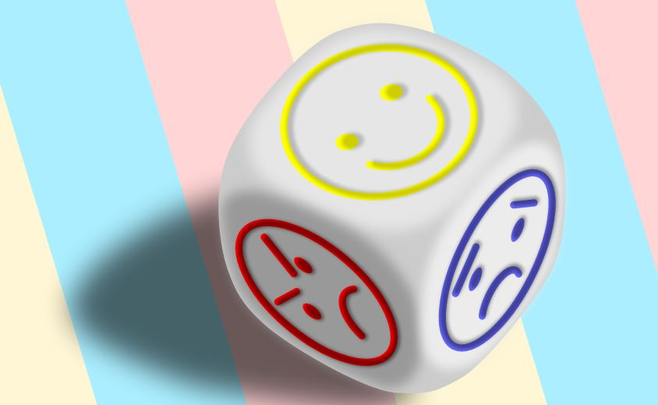
Mood Disorders
An illness in which people have uncontrollable mood changes
Kinds of Mood Disorders
Bi-Polar
Depression
Schizophrenia

Slide 27
Bi-Polar
Extreme changes in in mood, from mania to depression
Between these mood episodes, they experience normal moods

Slide 28
Manic
Describes an increasingly restless, energetic, talkative, reckless, powerful period
At some point, this up feeling can change into something darker
Irritation
Confusion
Anger
Feeling trapped

Slide 29
What is Mania
https://www.youtube.com/watch?v=KtHXzDqXy3w

Slide 30
Other Side Effects
Hallucination
Sensing something that is not real
Delusion
False belief

Slide 31
Schizophrenia
Person breaks from reality in several ways
Express little emotion; Unorganized thinking
Paranoia
Belief that other people want to harm someone

Slide 32
Schizophrenia Symptoms
Symptoms
Delusions
Thought disorders
Hallucinations
Lack of desire / motivation to accomplish goals
Lack of desire to form social relationships
Involve problems with attention and memory
http://www.youtube.com/watch?v=KBRAC4acr70

Slide 33
Depression
Mood disorder in which a person feels extremely sad and hopeless for at least 2 weeks
Major Depressive Disorder ( MDD)
Symptoms
Extreme sadness
Inability to cheer up
Changes in sleeping & eating patterns
Tiredness
Thoughts of death / suicide

Slide 34
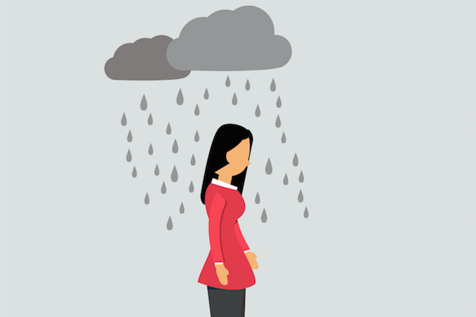
Depression Facts
40% are identified & diagnosed
Half of people with depression receive proper treatment
80% of those who are treated respond

Slide 35
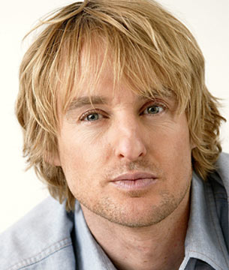
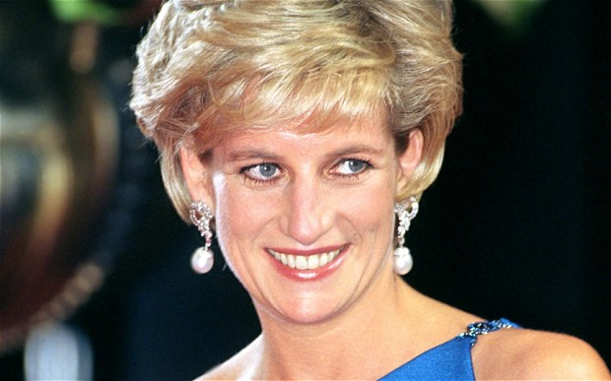

Slide 36
Bell Ringer
Scenario: A friend tells you that he or she is thinking about suicide. He or she asks you not to tell anyone.
What is the first thing that you should do?
Then what should you do?

Slide 37
Suicide
Suicidal Thinking
Is the desire to take one’s own life
15 % of people commit suicide
One of leading causes of death for teenagers

Slide 38
Suicide Statistics
Every year there are approximately 10 youth suicides for every 100,000 youth
Suicide is the 3rd leading cause of death for teens
8.5% of students in grades 9-12 reported a suicide within the last year
For every adolescent that commits suicide, there are between 50 and 200 attempts
1 in 5 high school students seriously considered suicide
1 in 6 had plans to attempt suicide

Slide 39
Helping a Suicidal person: What to do
Trust your feelings if you think the person is suicidal
Tell the suicidal person how concerned you are and how much you care
Talk calmly with the suicidal person
Find professional help
Stay with the person until help arrives
Be a listener

Slide 40
Helping a suicidal person: What not to do
Do not dare the person to make the attempt
Judge the suicidal person
Analyze the suicidal person’s motives
Argue or try to convince the suicidal person why he / she should not attempt suicide
Keep the suicidal person’s self destructive thoughts a secret
Leave a suicidal person alone
Do not delay dealing with the situation
Do not tell them about someone who has it worse
Do not say “ everything will be alright” or “pull it together”

Slide 41
Suicidal Prevention
https://www.youtube.com/watch?v=OT8lw1Rl-WM

Slide 42
National Suicide Prevention
http://www.suicidepreventionlifeline.org/

Slide 43
Treating Mental Disorders
Most people wait too long to seek help
Where to find help…
Teen Hotline
Phone number teens can call to talk to a person privately about their problems
Counselor
Professional who helps people through difficult problems by talking

Slide 44
Where to Find Help..
Psychologist
Person who tries to change thoughts, feelings, and actions by finding some reason behind them or by suggesting new ways to manage emotions
Psychiatrist
Medical doctor who specializes in illnesses of the brain and body that affect emotions and behavior

